Slide 1

DATA STRUCTURES AND ALGORITHMS (113215)
Dr. Owais Hussain

Slide 2

Agenda
Recap
How to write Recursive Algorithms
Sum of Numbers
Fibonacci Series
Complexity Analysis of Recursive algorithms
Tower of Hanoi Problem
OS Directory Tree

Slide 3
Sample 2
Recap
Recursion (also Recurrence) is one of the core concepts of algorithms. A wide range of problems are solved via recursion.
We already covered a few examples of recursion including Factorial calculation and Binary search.
Let’s go through a series of small exercises to get a grip on this subject.

Slide 4
Sample 2
How to Write Recursive Algorithms
A recursive algorithm can be designed using the following simple steps:
Identify the base case, i.e., the simplest case to solve.
Identify the condition to terminate the function so that it does not go on indefinitely. (Otherwise, be ready for StackOverflowException)
Identify the recursive case which breaks the sub-problem into simplest case.
Collect the output from recursive case by combining the solutions to sub-problems.

Slide 5
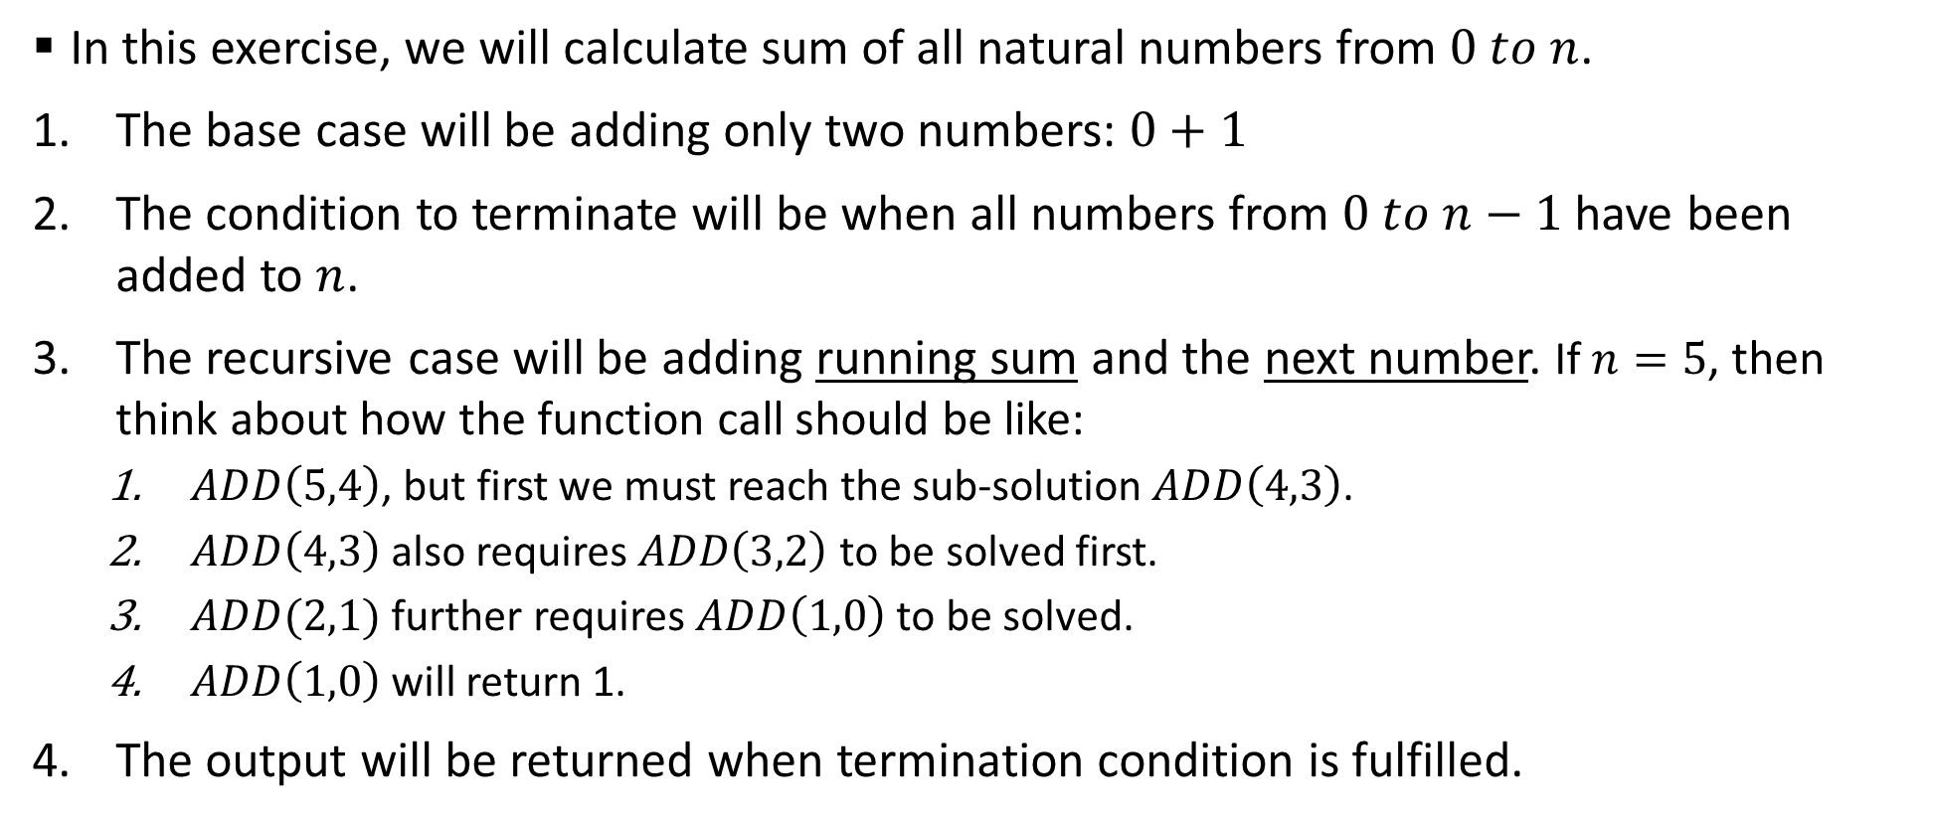
Sample 2
Sum of Numbers
In this exercise, we will calculate sum of all natural numbers from $0 to n$.
The base case will be adding only two numbers: $0+1$
The condition to terminate will be when all numbers from $0 to n−1$ have been added to $n$.
The recursive case will be adding running sum and the next number. If $n=5$, then think about how the function call should be like:
$ADD\left(5,4\right)$, but first we must reach the sub-solution $ADD\left(4,3\right)$.
$ADD\left(4,3\right)$ also requires $ADD\left(3,2\right)$ to be solved first.
$ADD(2,1)$ further requires $ADD\left(1,0\right)$ to be solved.
$ADD\left(1,0\right)$ will return 1.
The output will be returned when termination condition is fulfilled.

Slide 6
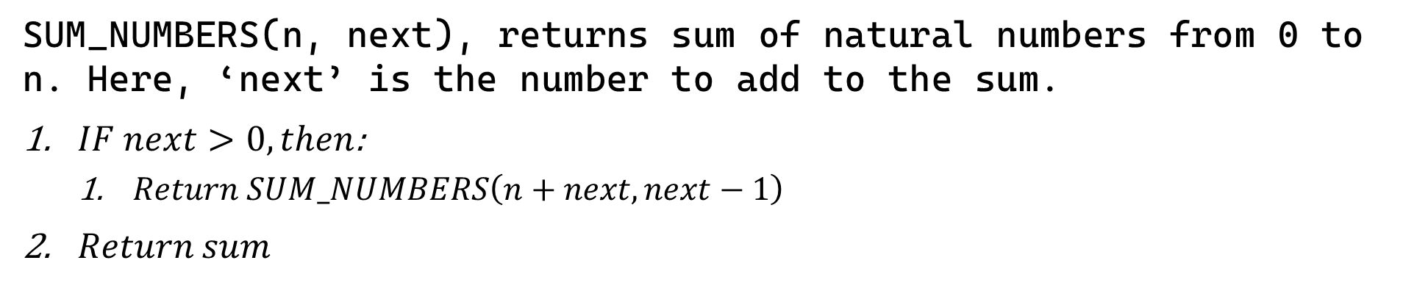
Sample 2
Sum of Numbers
SUM_NUMBERS(n, next), returns sum of natural numbers from 0 to n. Here, ‘next’ is the number to add to the sum.
$IF next>0, then$:
$Return SUM_NUMBERS\left(n+next, next−1\right)$
$Return sum$
This Pseudocode looks fine because it returns the sum of numbers from 0 to n. It also has a termination step and SUM_NUMBERS function is called within the function itself.
However, it does not fulfil all requirements of recursion. Because it immediately starts solving the problem before breaking it down to the base subproblem.

Slide 7
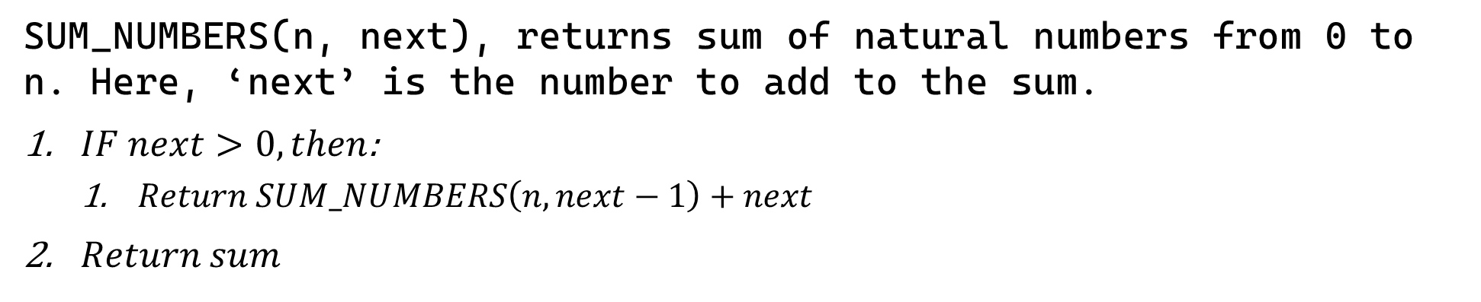
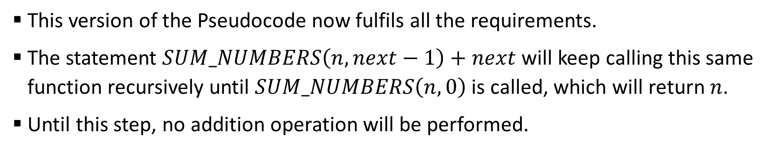
Sample 2
Sum of Numbers
SUM_NUMBERS(n, next), returns sum of natural numbers from 0 to n. Here, ‘next’ is the number to add to the sum.
$IF next>0, then$:
$Return SUM_NUMBERS\left(n, next−1\right)+next$
$Return sum$
This version of the Pseudocode now fulfils all the requirements.
The statement $SUM_NUMBERS\left(n, next−1\right)+next$ will keep calling this same function recursively until $SUM_NUMBERS\left(n,0\right)$ is called, which will return $n$.
Until this step, no addition operation will be performed.

Slide 8
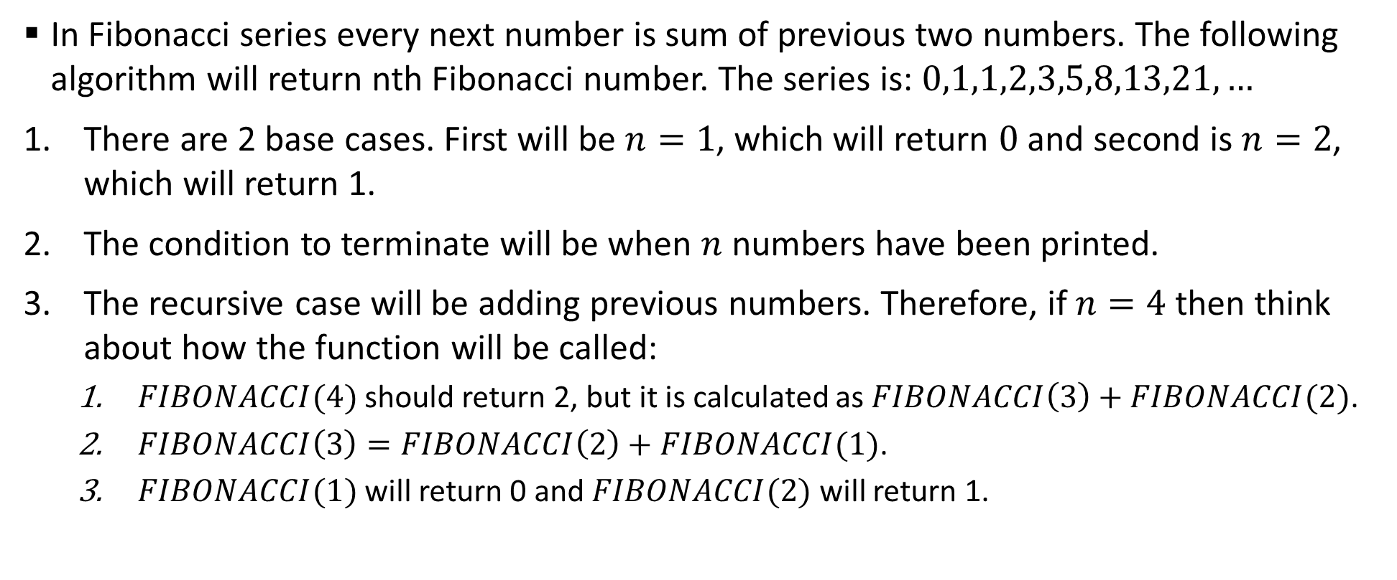
Sample 2
Fibonacci Series
In Fibonacci series every next number is sum of previous two numbers. The following algorithm will return nth Fibonacci number. The series is: $0,1,1,2,3,5,8,13,21,…$
There are 2 base cases. First will be $n=1$, which will return $0$ and second is $n=2$, which will return 1.
The condition to terminate will be when $n$ numbers have been printed.
The recursive case will be adding previous numbers. Therefore, if $n=4$ then think about how the function will be called:
$FIBONACCI(4)$ should return 2, but it is calculated as $FIBONACCI\left(3\right)+FIBONACCI(2)$.
$FIBONACCI\left(3\right)=FIBONACCI\left(2\right)+FIBONACCI(1)$.
$FIBONACCI(1)$ will return 0 and $FIBONACCI(2)$ will return 1.

Slide 9
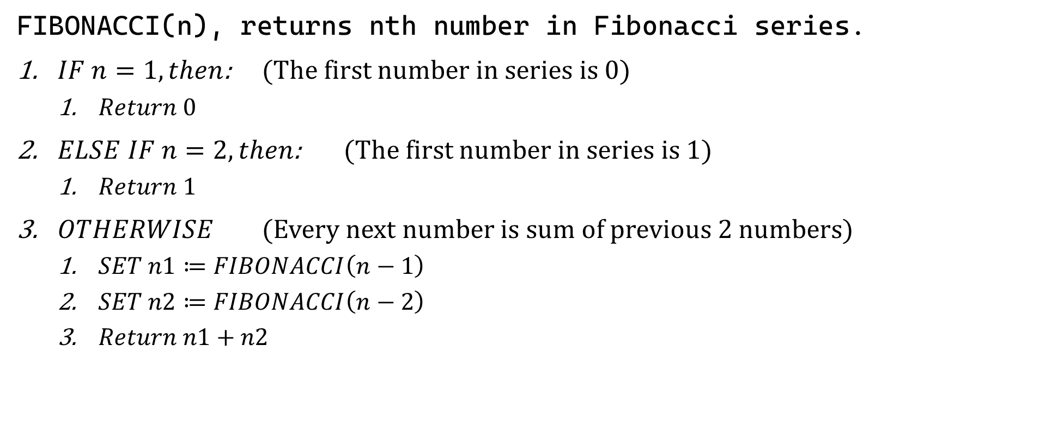
Sample 2
Fibonacci Series
FIBONACCI(n), returns nth number in Fibonacci series.
$IF n=1, then$: (The first number in series is 0)
$Return 0$
$ELSE IF n=2, then$: (The first number in series is 1)
$Return 1$
$OTHERWISE$ (Every next number is sum of previous 2 numbers)
$SET n1≔FIBONACCI\left(n−1\right)$
$SET n2≔FIBONACCI\left(n−2\right)$
$Return n1+n2$

Slide 10
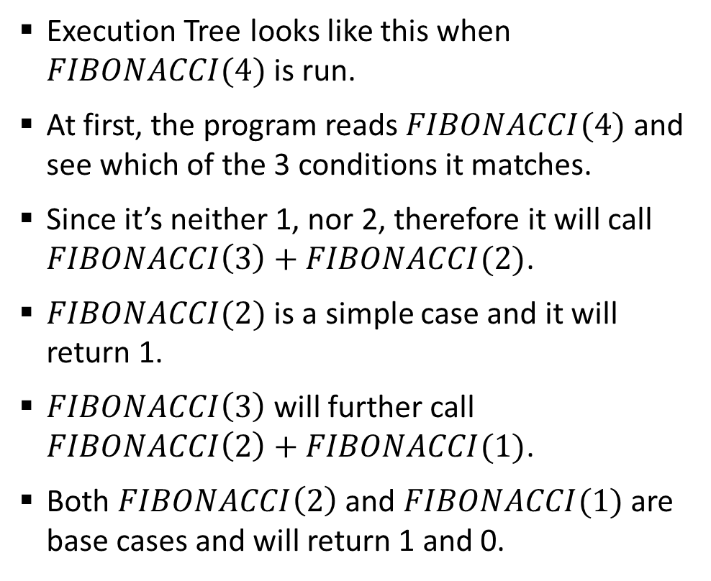
Sample 2
Fibonacci Series
Execution Tree looks like this when $FIBONACCI(4)$ is run.
At first, the program reads $FIBONACCI(4)$ and see which of the 3 conditions it matches.
Since it’s neither 1, nor 2, therefore it will call $FIBONACCI\left(3\right)+FIBONACCI(2)$.
$FIBONACCI(2)$ is a simple case and it will return 1.
$FIBONACCI\left(3\right)$ will further call $FIBONACCI\left(2\right)+FIBONACCI(1)$.
Both $FIBONACCI\left(2\right)$ and $FIBONACCI(1)$ are base cases and will return 1 and 0.
Fib(4)
Fib(3)
Fib(2)
Fib(2)
Fib(1)
1
0
1

Slide 11
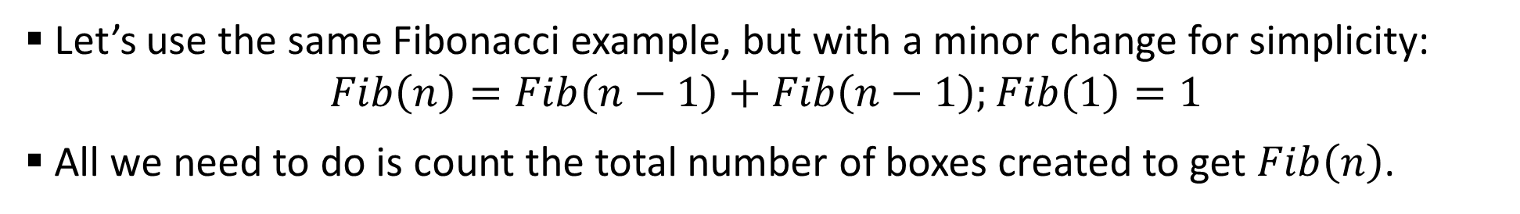
Sample 2
Complexity Analysis of Recursive algorithms
Let’s use the same Fibonacci example, but with a minor change for simplicity: $Fib\left(n\right)=Fib\left(n−1\right)+Fib\left(n−1\right);Fib\left(1\right)=1$
All we need to do is count the total number of boxes created to get $Fib\left(n\right)$.
Fib(3)
Fib(2)
Fib(1)
Fib(2)
Fib(1)
Fib(4)
Fib(3)
Fib(2)
Fib(2)
Fib(1)
Fib(1)
Fib(1)
Fib(1)
Fib(1)
Fib(1)
1
1
1
1
1
1
1
1

Slide 12
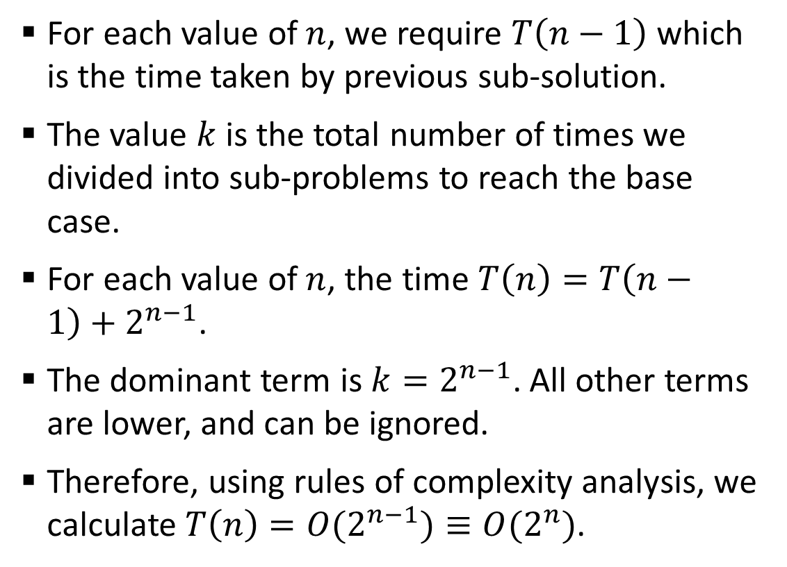
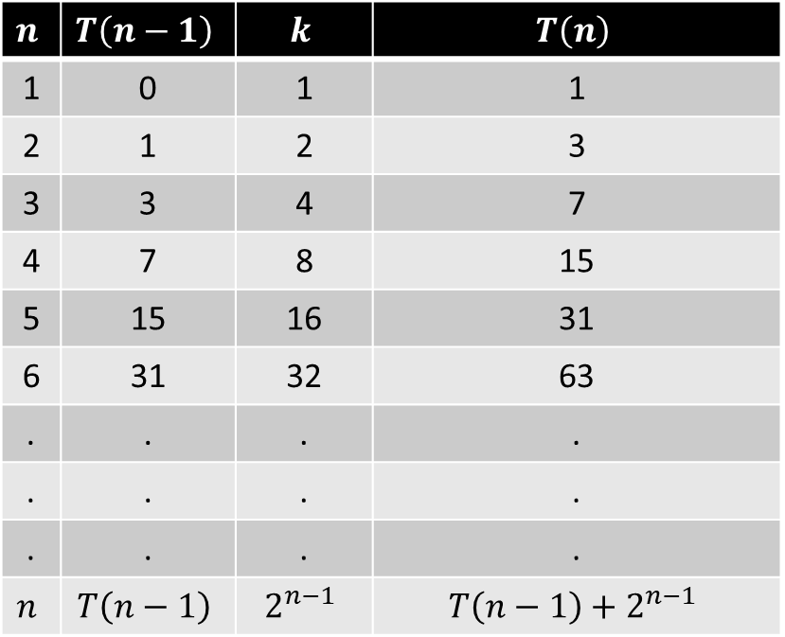
Sample 2
Fibonacci Series
For each value of $n$, we require $T\left(n−1\right)$ which is the time taken by previous sub-solution.
The value $k$ is the total number of times we divided into sub-problems to reach the base case.
For each value of $n$, the time $T\left(n\right)=T\left(n−1\right)+2^{n−1}$.
The dominant term is $k=2^{n−1}$. All other terms are lower, and can be ignored.
Therefore, using rules of complexity analysis, we calculate $T\left(n\right)=O(2^{n−1})≡O(2^{n})$.
$$n$$ | $$T\left(n−1\right)$$ | $$k$$ | $$T\left(n\right)$$
1 | 0 | 1 | 1
2 | 1 | 2 | 3
3 | 3 | 4 | 7
4 | 7 | 8 | 15
5 | 15 | 16 | 31
6 | 31 | 32 | 63
. | . | . | .
. | . | . | .
. | . | . | .
$$n$$ | $$T\left(n−1\right)$$ | $$2^{n−1}$$ | $$T\left(n−1\right)+2^{n−1}$$

Slide 13
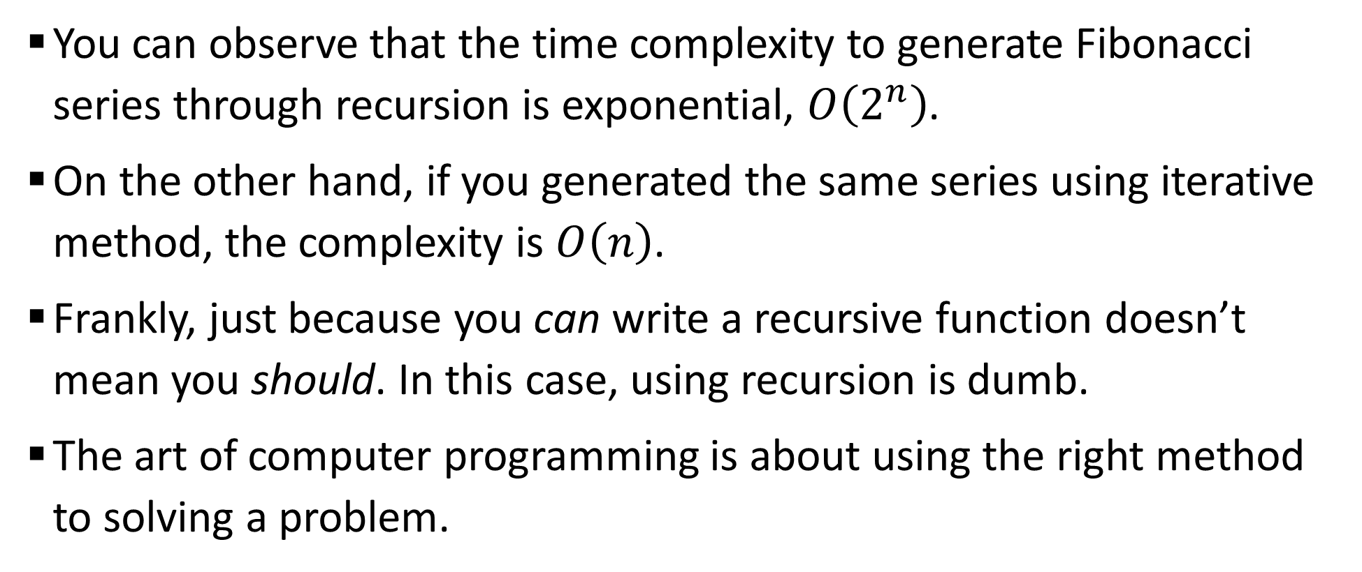
Sample 2
Fibonacci Series
You can observe that the time complexity to generate Fibonacci series through recursion is exponential, $O\left(2^{n}\right)$.
On the other hand, if you generated the same series using iterative method, the complexity is $O\left(n\right)$.
Frankly, just because you can write a recursive function doesn’t mean you should. In this case, using recursion is dumb.
The art of computer programming is about using the right method to solving a problem.

Slide 14
Sample 2
Tower of Hanoi Problem
The rules of this game are:
All cylinders must be moved from first post to the last.
Only one cylinder can be moved at a time.
A larger cylinder cannot be put over a smaller cylinder.
Cylinders can be moved back and forth any number of times.

Slide 15
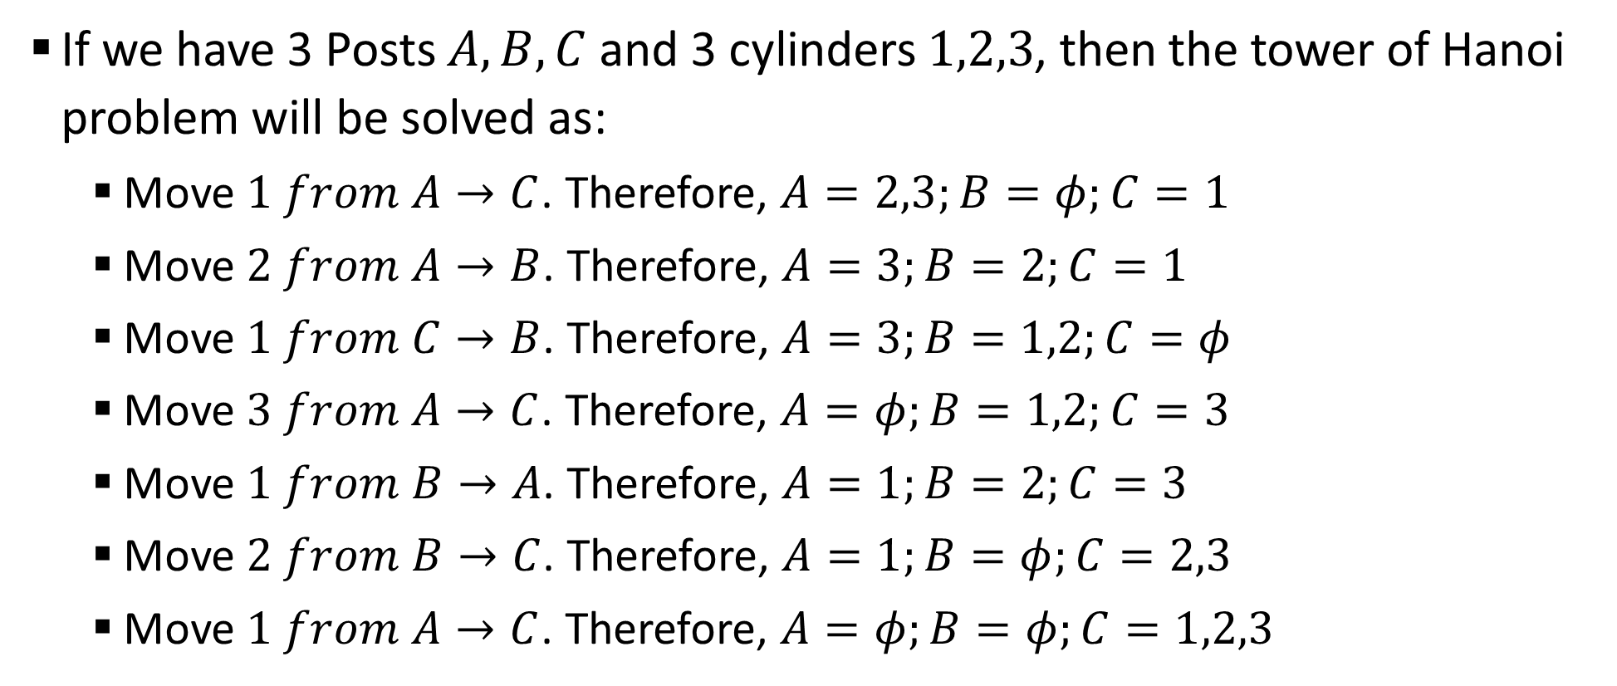
Sample 2
Tower of Hanoi Problem
If we have 3 Posts $A,B,C$ and 3 cylinders $1,2,3$, then the tower of Hanoi problem will be solved as:
Move $1 from A→C$. Therefore, $A=2,3;B=φ;C=1$
Move $2 from A→B$. Therefore, $A=3;B=2;C=1$
Move $1 from C→B$. Therefore, $A=3;B=1,2;C=φ$
Move $3 from A→C$. Therefore, $A=φ;B=1,2;C=3$
Move $1 from B→A$. Therefore, $A=1;B=2;C=3$
Move $2 from B→C$. Therefore, $A=1;B=φ;C=2,3$
Move $1 from A→C$. Therefore, $A=φ;B=φ;C=1,2,3$

Slide 16
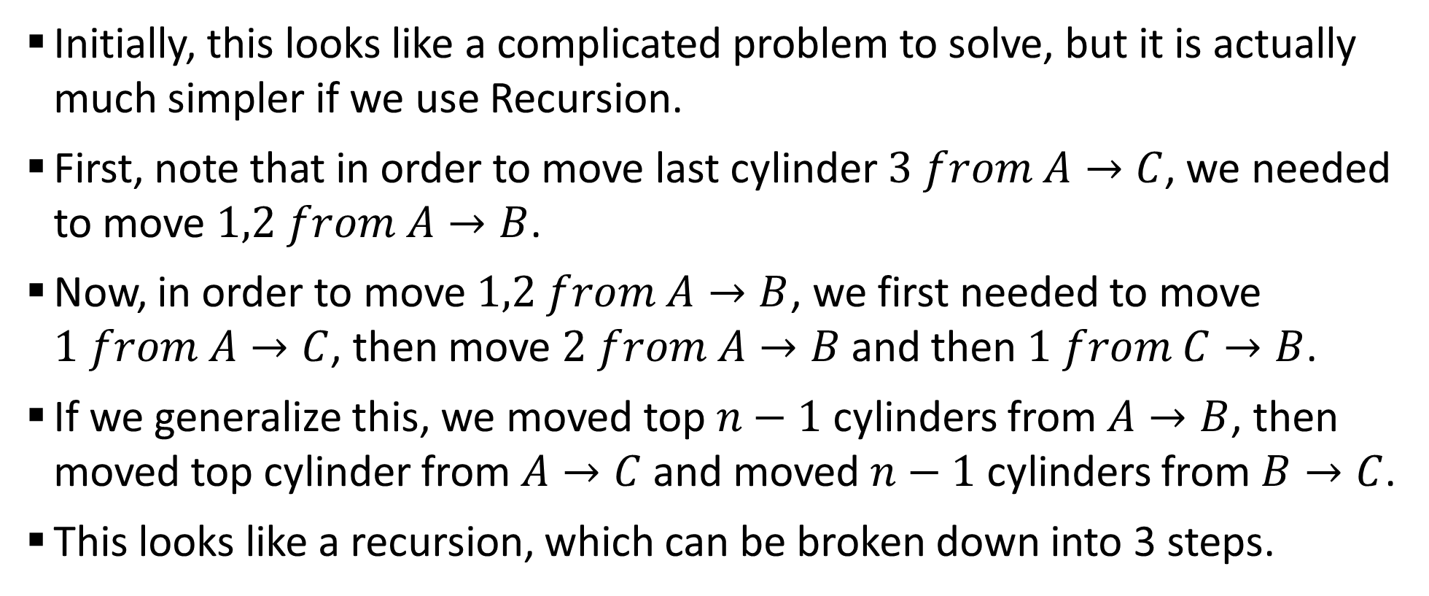
Sample 2
Tower of Hanoi Problem
Initially, this looks like a complicated problem to solve, but it is actually much simpler if we use Recursion.
First, note that in order to move last cylinder $3 from A→C$, we needed to move $1,2 from A→B$.
Now, in order to move $1,2 from A→B$, we first needed to move $1 from A→C$, then move $2 from A→B$ and then $1 from C→B$.
If we generalize this, we moved top $n−1$ cylinders from $A→B$, then moved top cylinder from $A→C$ and moved $n−1$ cylinders from $B→C$.
This looks like a recursion, which can be broken down into 3 steps.

Slide 17
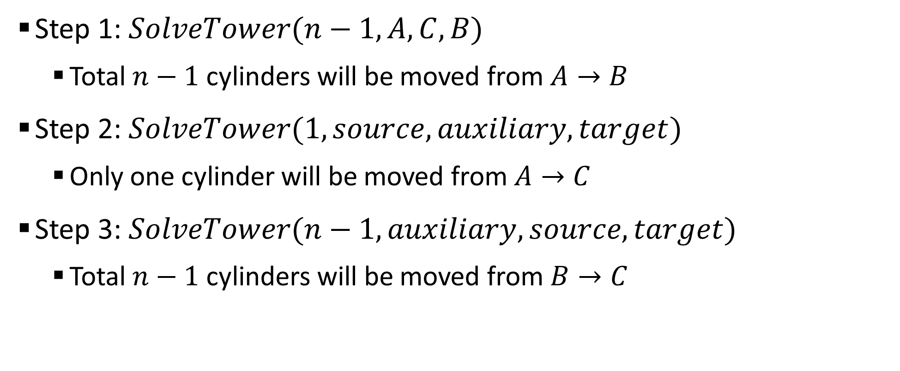
Sample 2
Tower of Hanoi Problem
Step 1: $SolveTower(n−1, A, C, B)$
Total $n−1$ cylinders will be moved from $A→B$
Step 2: $SolveTower(1, source,auxiliary, target)$
Only one cylinder will be moved from $A→C$
Step 3: $SolveTower(n−1, auxiliary,source, target)$
Total $n−1$ cylinders will be moved from $B→C$

Slide 18
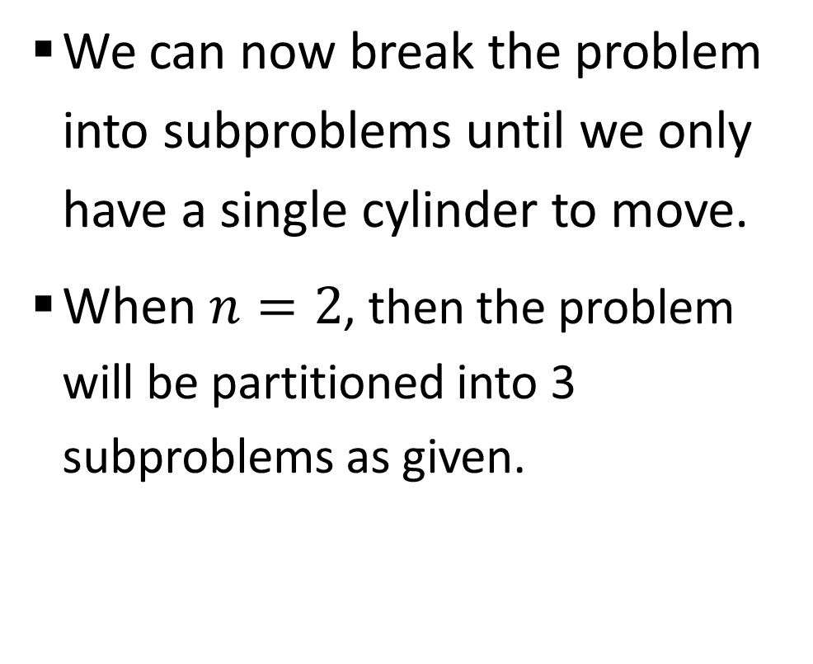
Sample 2
Tower of Hanoi Problem
We can now break the problem into subproblems until we only have a single cylinder to move.
When $n=2$, then the problem will be partitioned into 3 subproblems as given.
H(2)
A to B
A to C
B to C

Slide 19
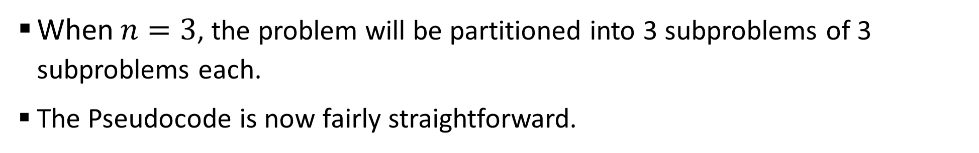
Sample 2
Tower of Hanoi Problem
When $n=3$, the problem will be partitioned into 3 subproblems of 3 subproblems each.
The Pseudocode is now fairly straightforward.
H(3)
H(2)
H(2)
H(2)
A to B
A to C
B to C
A to B
A to C
B to C
A to B
A to C
B to C

Slide 20
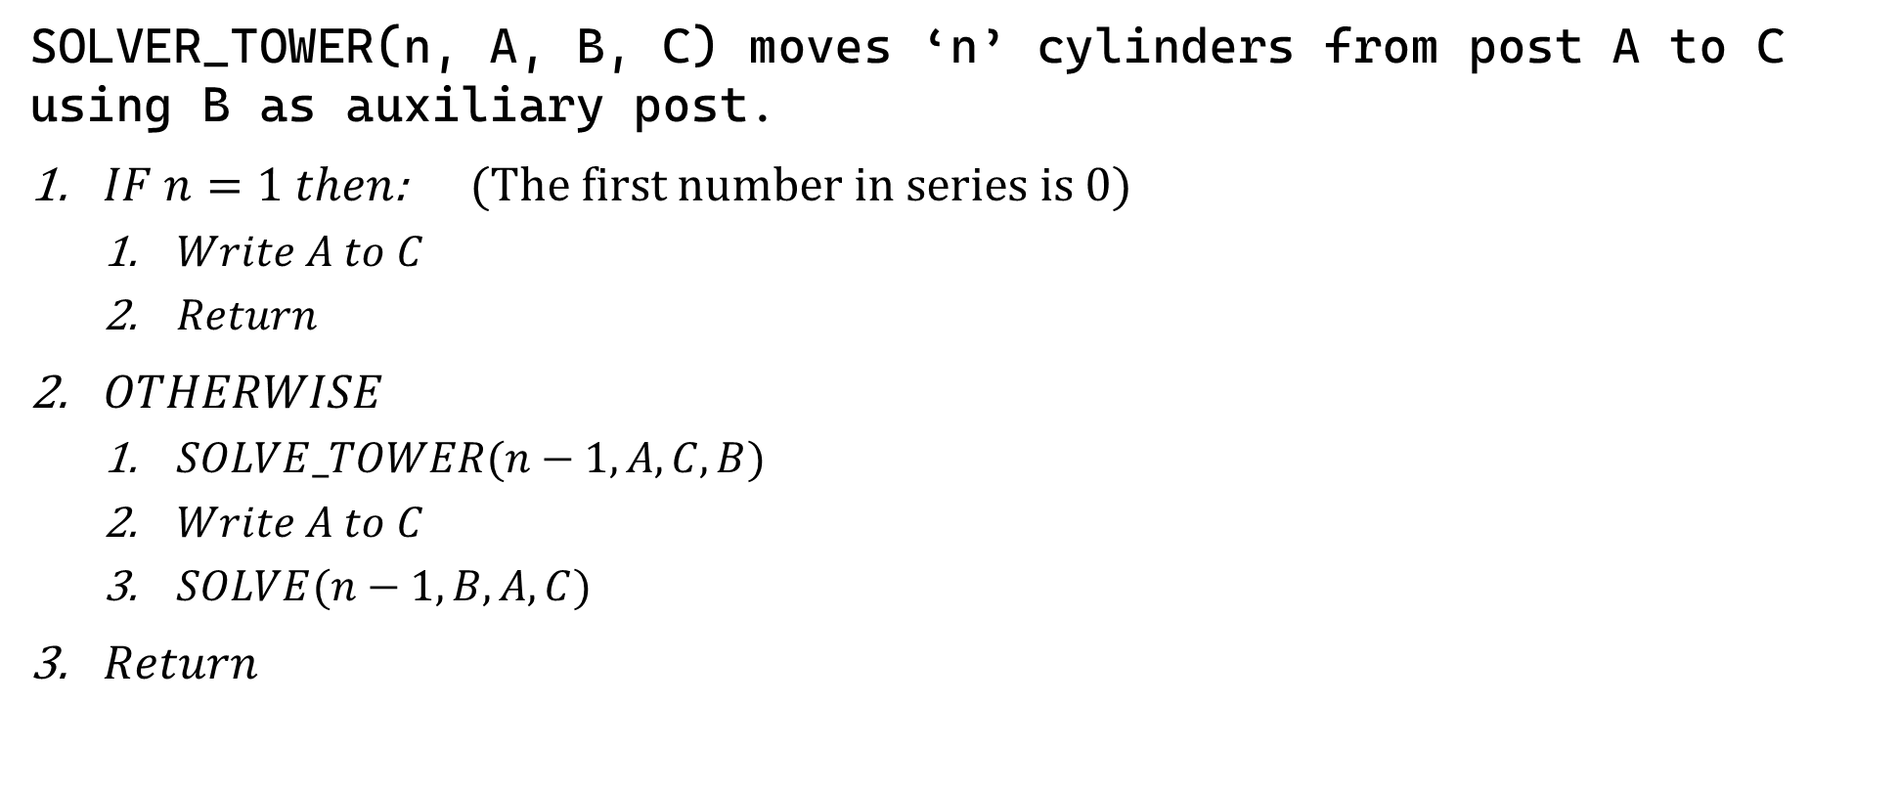
Sample 2
Tower of Hanoi Problem
SOLVER_TOWER(n, A, B, C) moves ‘n’ cylinders from post A to C using B as auxiliary post.
$IF n=1 then$: (The first number in series is 0)
$Write A to C$
$Return$
$OTHERWISE$
$SOLVE_TOWER(n−1,A,C,B)$
$Write A to C$
$SOLVE(n−1,B,A,C)$
$Return$

Slide 21
Sample 2
OS Directory Tree
How does an OS keep track of all directories and files?
Execute the following commands (Windows) and see what happens:
C:\Users>dir /s
The “dir” command displays all files in a directory and “/s” switch tells it to include all subdirectories in the “Users” directory.
This is a recursive command and traverses each directory. If there are any subdirectories inside that directory, it goes inside the subdirectories and calls the same function on it.

Slide 22
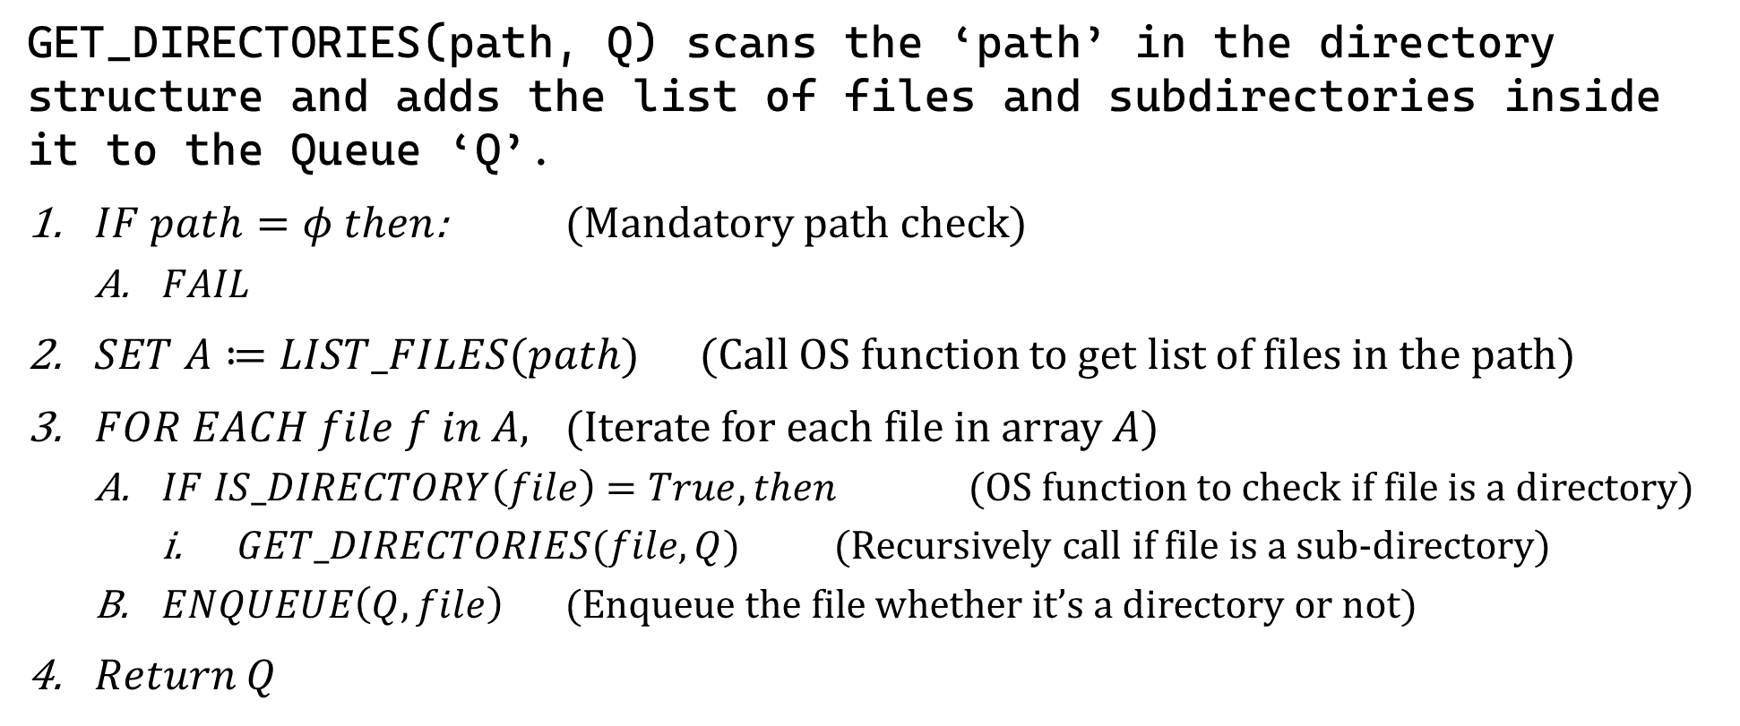
Sample 2
OS Directory Tree
GET_DIRECTORIES(path, Q) scans the ‘path’ in the directory structure and adds the list of files and subdirectories inside it to the Queue ‘Q’.
$IF path=φ then$: (Mandatory path check)
$FAIL$
$SET A≔LIST_FILES(path)$ (Call OS function to get list of files in the path)
$FOR EACH file f in A,$ (Iterate for each file in array $A$)
$IF IS_DIRECTORY\left(file\right)=True, then$ (OS function to check if file is a directory)
$GET_DIRECTORIES(file, Q)$ (Recursively call if file is a sub-directory)
$ENQUEUE\left(Q,file\right)$ (Enqueue the file whether it’s a directory or not)
$Return Q$
Notes:
Remember! A directory for OS is a special file which can be used to keep other files.

Slide 23



THANK YOU
Owais Hussain
+92 345-3174270
owais.hussain@kiet.edu.pk
https://www.researchgate.net/profile/Owais-Hussain-3

